Slide 1
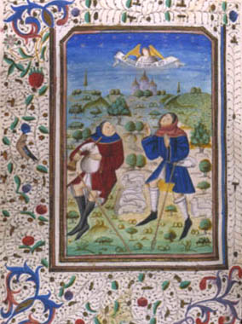
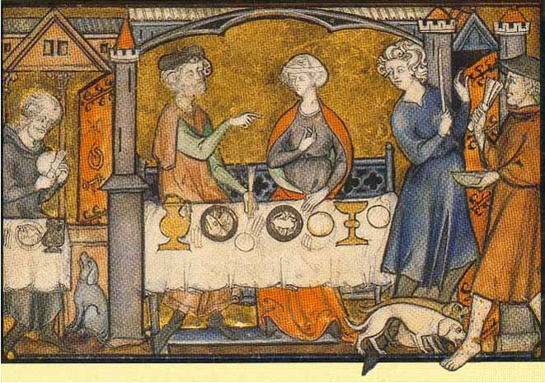
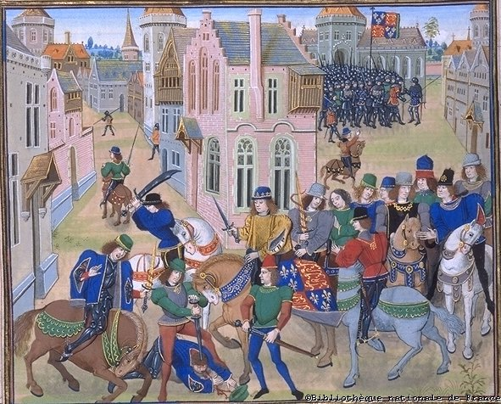
Late Middle Ages - PPT #1

Slide 2
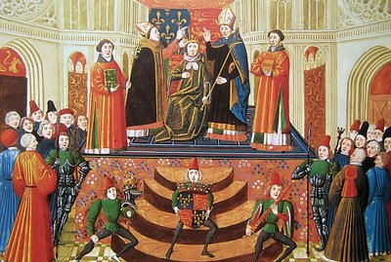
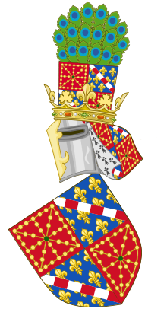
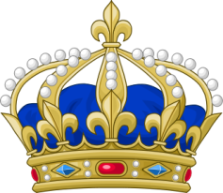
Ch 8, Sec. 1:
Royal Power Grows
1000 – 1300 AD Monarchs started gaining more power
Monarchs strengthened ties with townspeople
Townspeople became loyal to the royal ruler
Unity increased trade
nationalism begin to grow.

Slide 3
In 1066, England was invaded by William of Normandy – William the Conqueror
Anglo-Saxons select Edward’s brother-in-law Harold to be King – he breaks promise to Wm of Normandy
King of England dies without children – promises throne to cousin – Duke William of Normandy (N. France)
King of Norway says he should inherit crown – loves to fight and attacks England (berserking)
Harold G. defeats Hadrada – Wm’s army sets sail for England. Harold’s army marches 250 miles south to meet Normans
Normandy
Harold’s army relies on two- handed battle-ax
William’s army uses flurries of arrows - crossbow, cavalry
Normans win by faking retreat and then turning and attacking the Saxons
Norman culture changes Saxon traditions
French words blended with Anglo-Saxon language
Established feudal system in England – increased power of English Monarch

Slide 4
William strengthened his power by ordering a survey of his realm – the results were the Domesday Book
His son Henry I used this information to collect taxes more effectively.
William’s grandson, Henry II established a uniform system of justice, leading to Common Law- justice was uniform and applied to all. He also created a central bureaucracy.

Slide 5
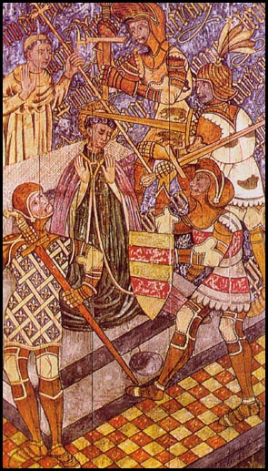
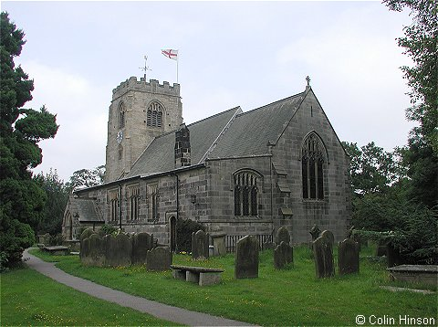
The Church said their allegiance was to the Pope not to the King
This led to a clash between Henry and his friend, Thomas Beckett, the Archbishop of Canterbury
Henry had his men murder Thomas in his own church – Beckett was proclaimed a saint
Henry had to confess his fault and give up his efforts to make the Church subject to the King’s law

Slide 6
Assumed throne after death of brother, Richard “The Lionhearted”-who was wounded in the crusades
Raising taxes. Demanding money for your war with France and losing land. Engaging in a quarrel with the Pope
“If I sign this document…I will be giving power to the Lords and the English people.”
--Cruel, ignorant, and unpopular
Limited Monarch’s Power-no imprisonment without jury trial-no taxes without lord’s consent-no interference with the church
During the reign of Henry’s son John, the nobility rebelled against the growth of royal power. In 1215 they forced John to sign the MAGNA CARTA – the King must follow the law

Slide 7
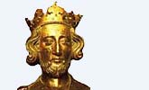
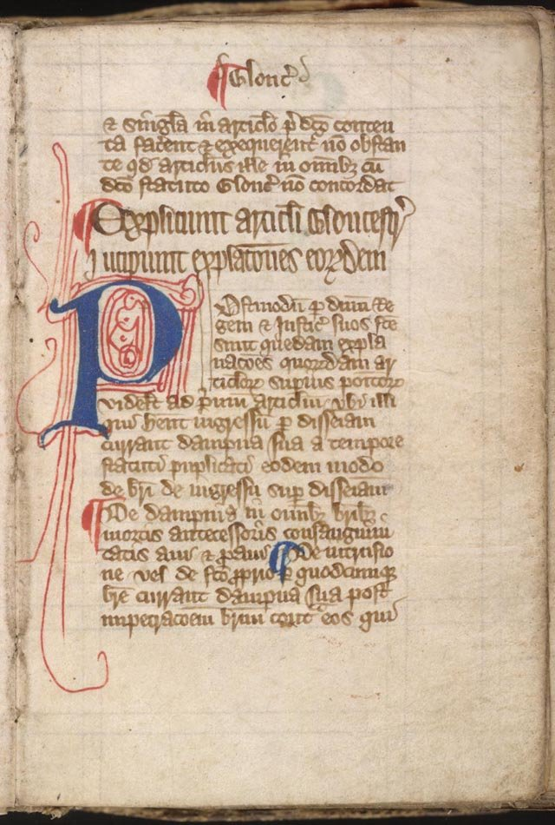
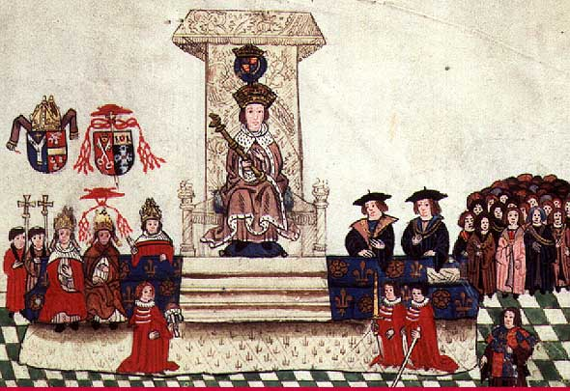
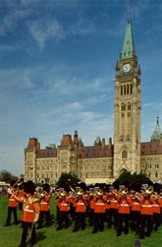
The Magna Carta laid the foundation of a limited monarchy in which the king must share power with his subjects.
This eventually led to the creation of Parliament , which includes the House of Lords and the House of Commons --- THE LEGISLATIVE BRANCH OF GOVERNMENT

Slide 8
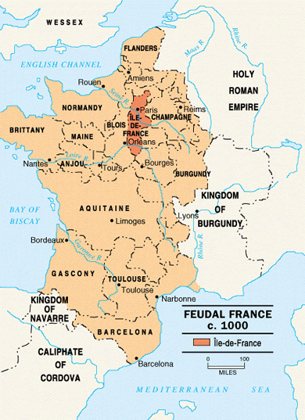
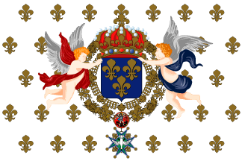
In France, the High Middle Ages was marked by the slow emergence of a central monarch . However, France remained largely feudal
For over 500 years the French monarchy slowly and methodically increased its control over that of the feudal nobility and its traditional English rivals

Slide 9
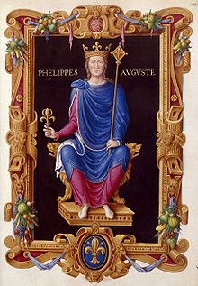
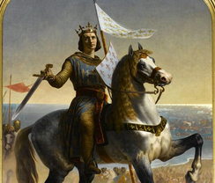
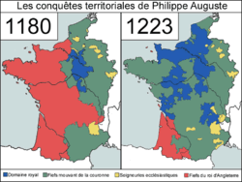
In 1179 Phillip II became king of France
He paid middle class officials who became loyal to him
He quadrupled royal holdings and gained control of English held lands
By his death in 1223 he became the most powerful ruler in Europe

Slide 10
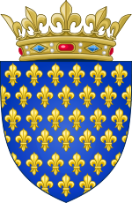
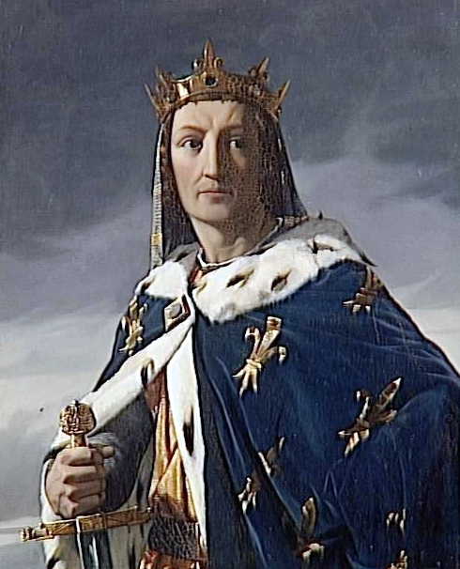
In 1226 Louis IX (the 9th) became King of France
He persecuted heretics and Jews
He sent knights to two crusades
He improved royal government – He outlawed private wars and serfdom and heard legal cases himself
By 1270 France had an efficient centralized monarchy

Slide 11
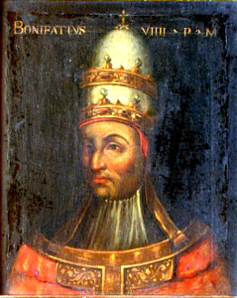
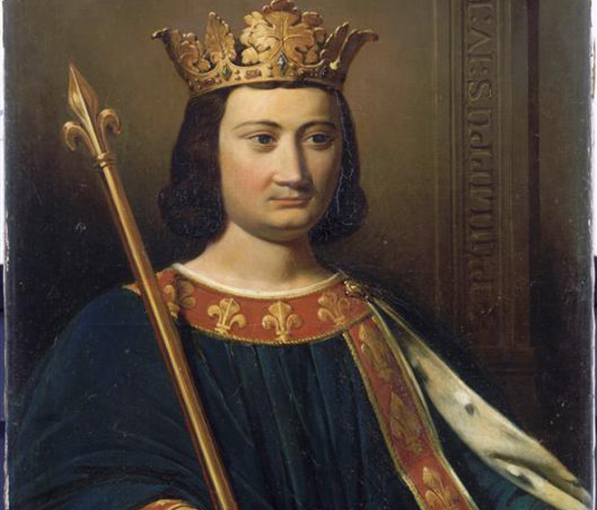
Louis’s grandson, Philip IV (the 4th) clashed with the Pope
The Pope said “God has set popes over kings and kingdoms”
Philip wanted to force the clergy to collect taxes for him and sent troops to arrest the Pope. He escaped but died soon after.
Four years later, in 1305, a French Pope was elected and the papal court was moved to Avignon
Another Pope was elected in Rome and this caused a crisis in the church – each claimed to be the true leader of the church

Slide 12
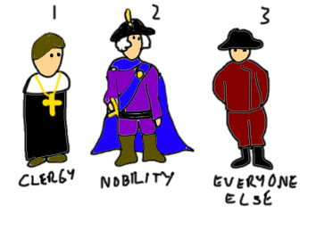
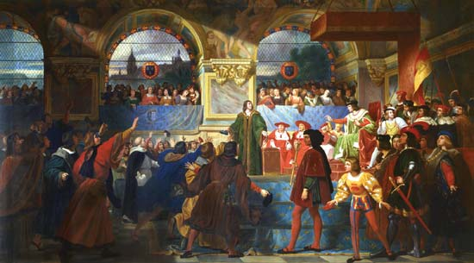
Philip set up the Estates General in 1302
It had representatives from all three estates, or classes:
1st estate -clergy
2nd Estate – nobles
3rd Estate –townspeople (almost everyone was in the 3rd Estate, from the very poor to wealthy merchants)
Later, French kings would sometimes consult the Estates General but it never served to balance the royal power – French Kings could just ignore them ☹

